Slide 2
Creating your first Website with VS Code and hosting on GitHub Pages
Manish Kumar Barnwal & Sagnik Mitra

Slide 3
Flow of the Event:
Navigating GitHub
Creating a unique repository
Writing in Markdown
Creating your first Jekyll website
Hosting with GitHub Pages
Make your first PR (Activity)
QnA

Slide 4


market
highlight
history
services
timeline
about
GitHub
NAT FRIEDMAN
CEO, GITHUB
American multinational corporation that provides hosting for software development and version control using Git. Currently, a Subsidiary of Microsoft from 2018

Slide 5



2008
2009
2012
1
2
3
DEVELOPED
ANNOUCED
VALUATION
market
history
services
highlight
timeline
The GitHub service was developed with Ruby on Rails, and started in February 2008
That the Site was used by over 1M users and have over 5M repositories.
Of $750 million after they Here raised $100 million in funding from A.Horowitz
about

Slide 6
market
history
services
highlight
timeline
about
2016
2018
2020
THE FORBES LIST
MICROSOFT
ARCHIVE PROGRAM
BEING THE BIGGEST CLOUD SOURCE CODE MANAGEMENT SYSTEM, THEY WERE IN THE TOP 15 IN THE FORBES CLOUD LIST OF 2016
MICROSOFT ACQUIRED GITHUB FOR $7.5 BILLION IN STOCK. THIS DEAL HEIGHTENED MICROSOFT’S FOCUS ON OPEN-SOURCE DEVELOPMENT
GITHUB ARCHIVE PROGRAM WAS ESTABLISHED, TO ARCHIVE ITS OPEN SOURCE CODE IN PERPETUITY, AND SOON AFTER THEY LAUNCHED THEIR OWN CLI.

Slide 7



01
02
03
market
history
services
highlight
timeline
about
ATOM
ELECTRON
OPEN-SOURCE GIANT
SOURCE-CODE & TEXT IDE
SOFTWARE FRAMEWORK
THE BIGGEST PLATFORM
A Platform Independent Open Source IDE for text and Source Code developed and maintained by GitHub
Developed and maintained by GitHub. Used for creating Native Applications using Web Technologies
Used by almost every Big Companies & Startups in the world to manage Source Code & for Version Control

Slide 8






Version Control System
Marketplace service
Provide distributed version-control system for tracking changes in source code during software development with data integrity and distributed workflows
SaaS Cloud Service Integration to provide services like Project management, automated code analysis, real time debugger, full stack exception handler etc.
Source Code Management
GitHub Pages
history
market
services
highlight
Tracks modifications to a source code repository, gives a running history of changes to a code base to resolve conflicts when merging from multiple contributors
A static web hosting service offered to users for hosting user blogs, project documentation, or even whole books scripted as a page
timeline
about
Education Program
GitHub Enterprise
Student Developer Pack to give students free access to popular development tools and services & Campus Expert Program to grow the community
A self-managed version of with similar functionality. It can be run on an organization's own hardware or on a cloud provider

Slide 9
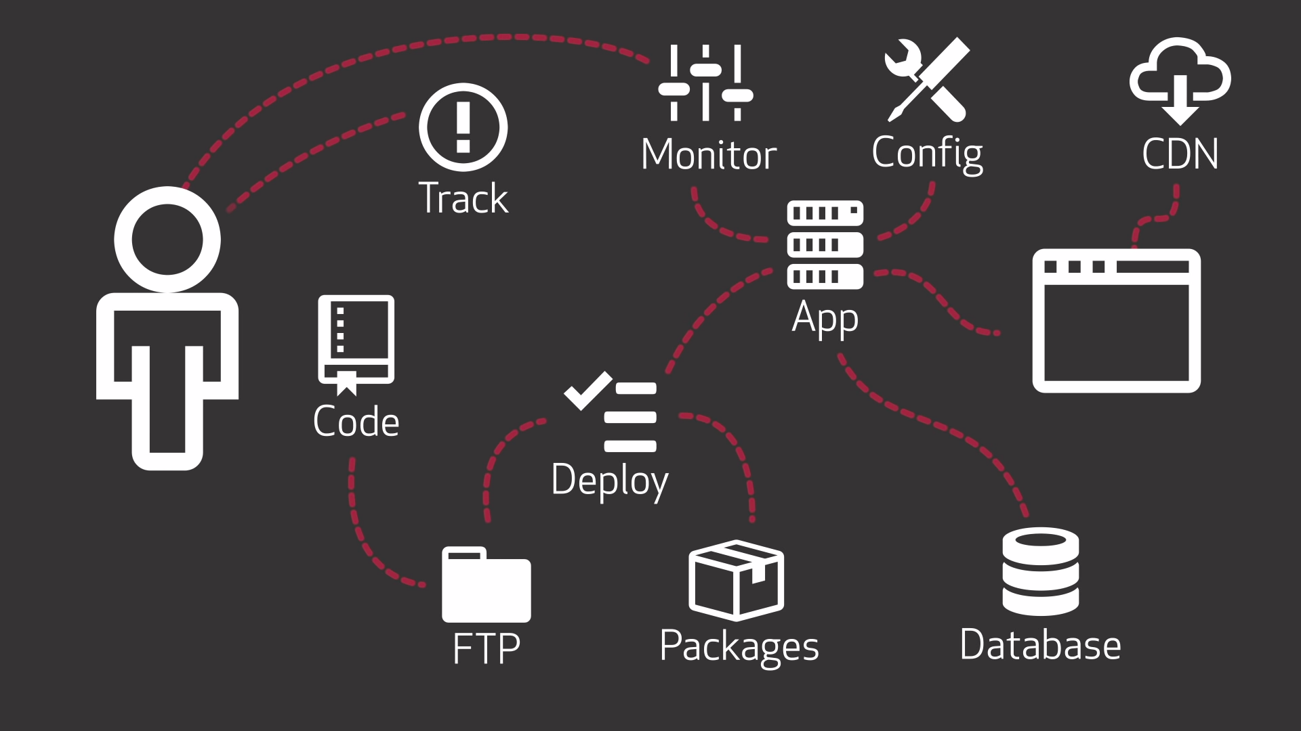

Slide 10


Slide 11
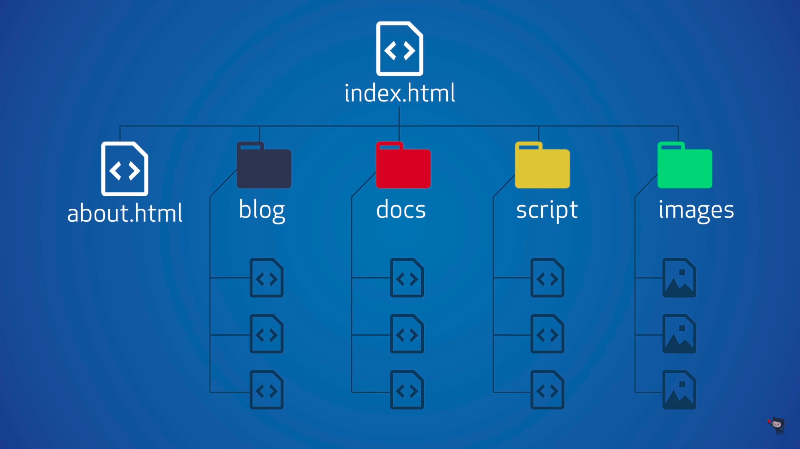

Slide 12
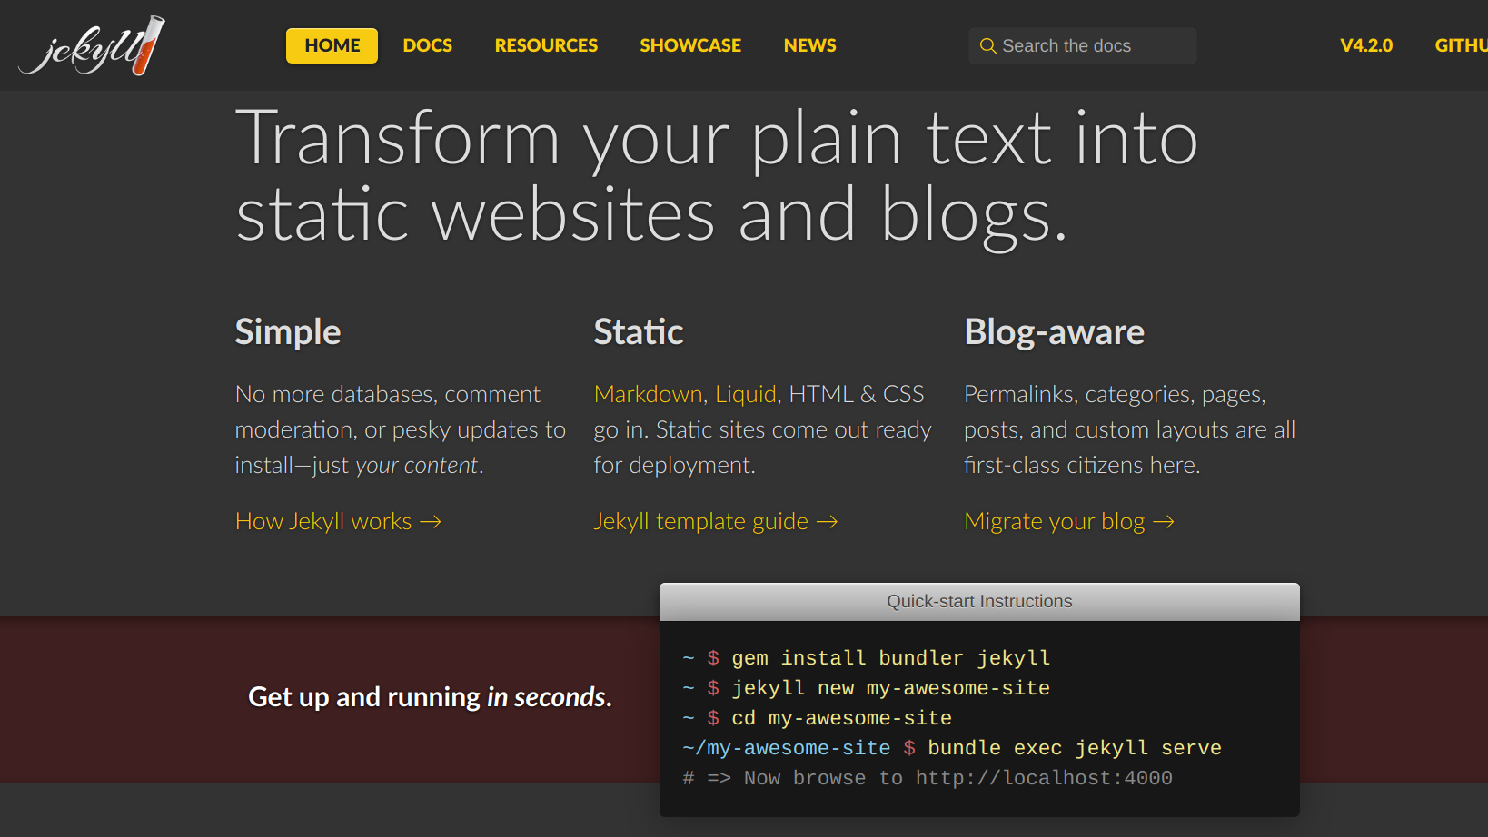

Slide 13
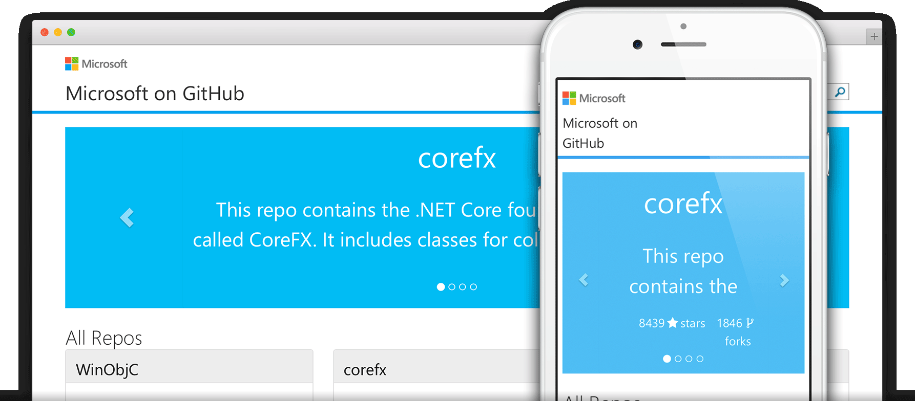
One Site Per Account
Repo: username.github.io
Branch: Master
URL: https://username.github.io

Slide 14
Markdown Syntax
Markdown is a way to style text on the web. You control the display of the document; forming words as bold or italic, adding images, and creating lists are just a few of the things we can do with Markdown. Mostly, Markdown is just regular text with a few non-alphabetic characters thrown in, like # or *.
Cheat Sheet: https://guides.github.com/pdfs/markdown-cheatsheet-online.pdf

Slide 15



Manish Kr. Barnwal

Slide 16


Sagnik Mitra

Slide 17
Resources:
Learn GitHub: https://docs.microsoft.com/en-us/learn/github
Git Cheat Sheet: https://education.github.com/git-cheat-sheet-education.pdf
Jekyll Docs: https://jekyllrb.com/docs/
GitHub Pages: https://pages.github.com/
GitHub Pages Theme: https://pages.github.com/themes
Dependencies: https://pages.github.com/versions
Presentation Deck: http://bit.ly/mlsa-ghpages-ppt
Repository Link:

Slide 18
Thank You. Any questions? Contact : manish.barnwal@studentambassadors.com sagnik.mitra@studentambassadors.com

